Slide 1
Assignment on Sample Superstore (Formatting Visualization and Analysis)
Submitted By: Pooran Pragnya
November Batch (BDS)

Slide 2
Scenarios for the Case Study
Find the profit and sales for each subcategory of every type of product
Which category has highest profit in the year 2019?
In case1, change the color of the view from the marks card.
In the view, in the sub category filter card, clear all of the check boxes except Bookcase, Machines and Tables to have closer look on each value.
Find out the key insights about in which year Bookcases and Machines were Profitable and unprofitable.

Slide 3
6. Show the sales region-wise for every subcategory and category and for every year.
7. Duplicate your worksheet and check sales region-wise for machine type subcategory.
8. In which region you are reporting a higher negative profit overall than in your other regions.
9. Show your view for sales in the south for all subcategories.
10. Which subcategory has highest overall negative profit in the south region.
11. Take some decision to improve profit in the south.
12. Rename your worksheet
13.Save your workbook.

Slide 4
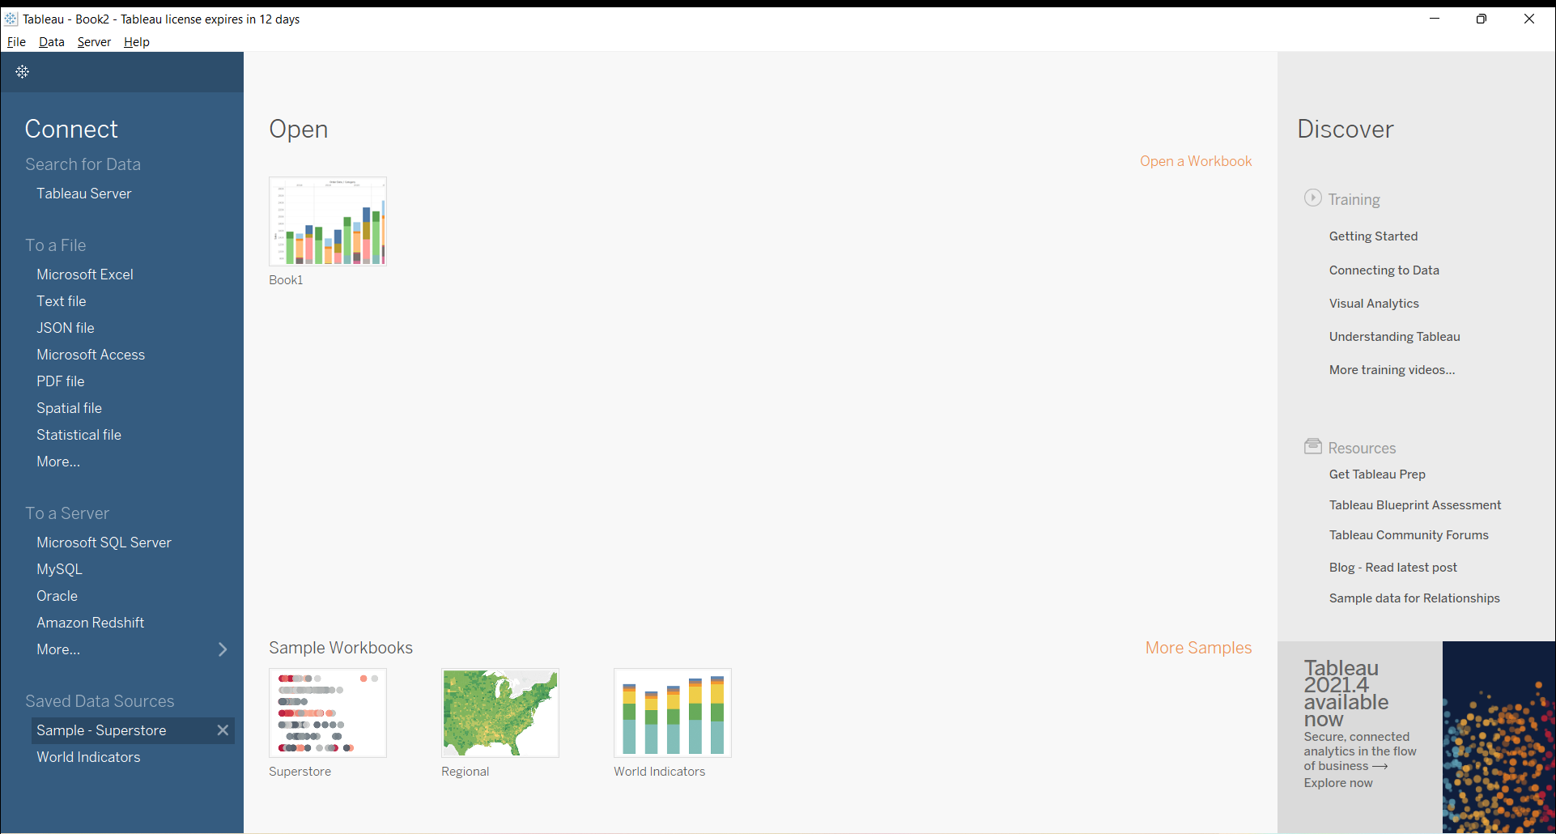

Slide 5
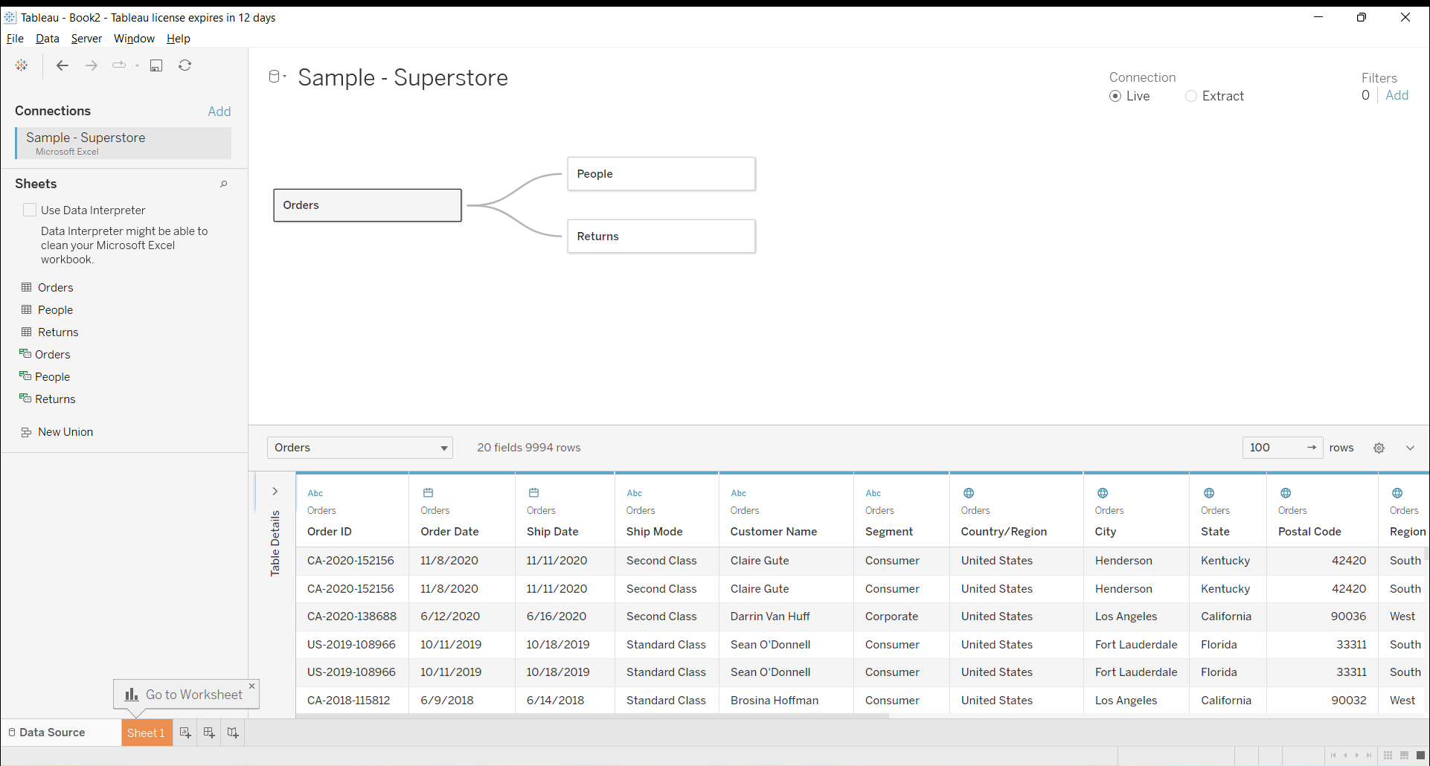

Slide 6
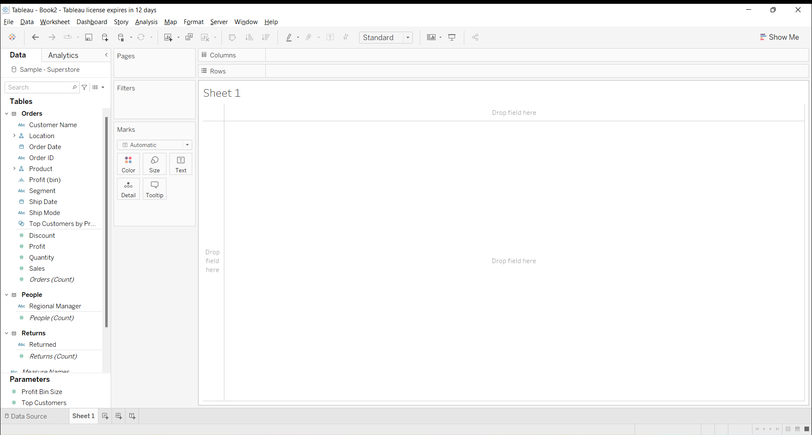

Slide 7
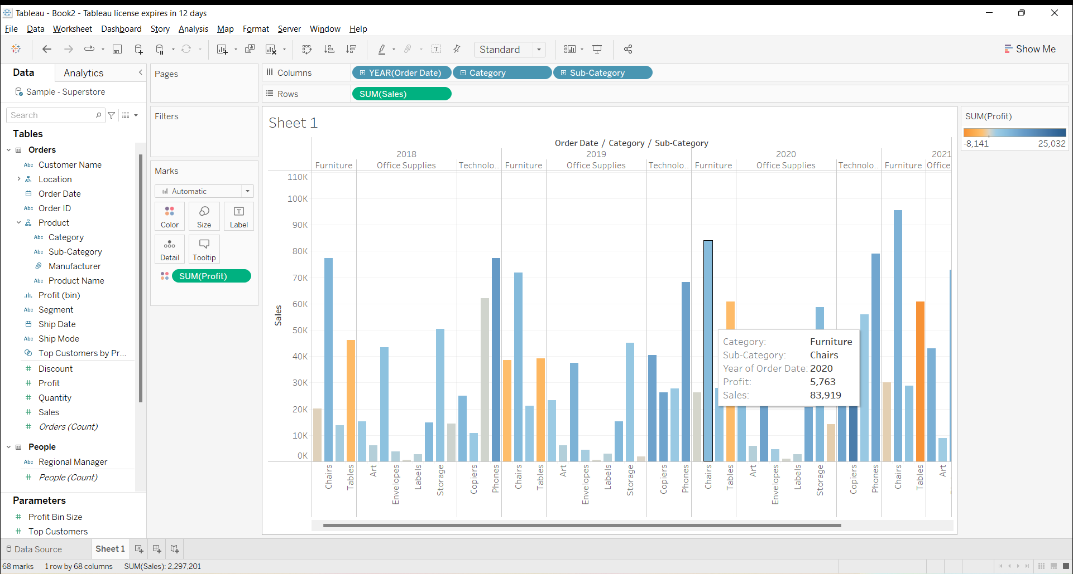
1. Find the profit and sales for each subcategory of every type of product

Slide 8

2. Which category has highest profit in the year 2019?

Slide 9
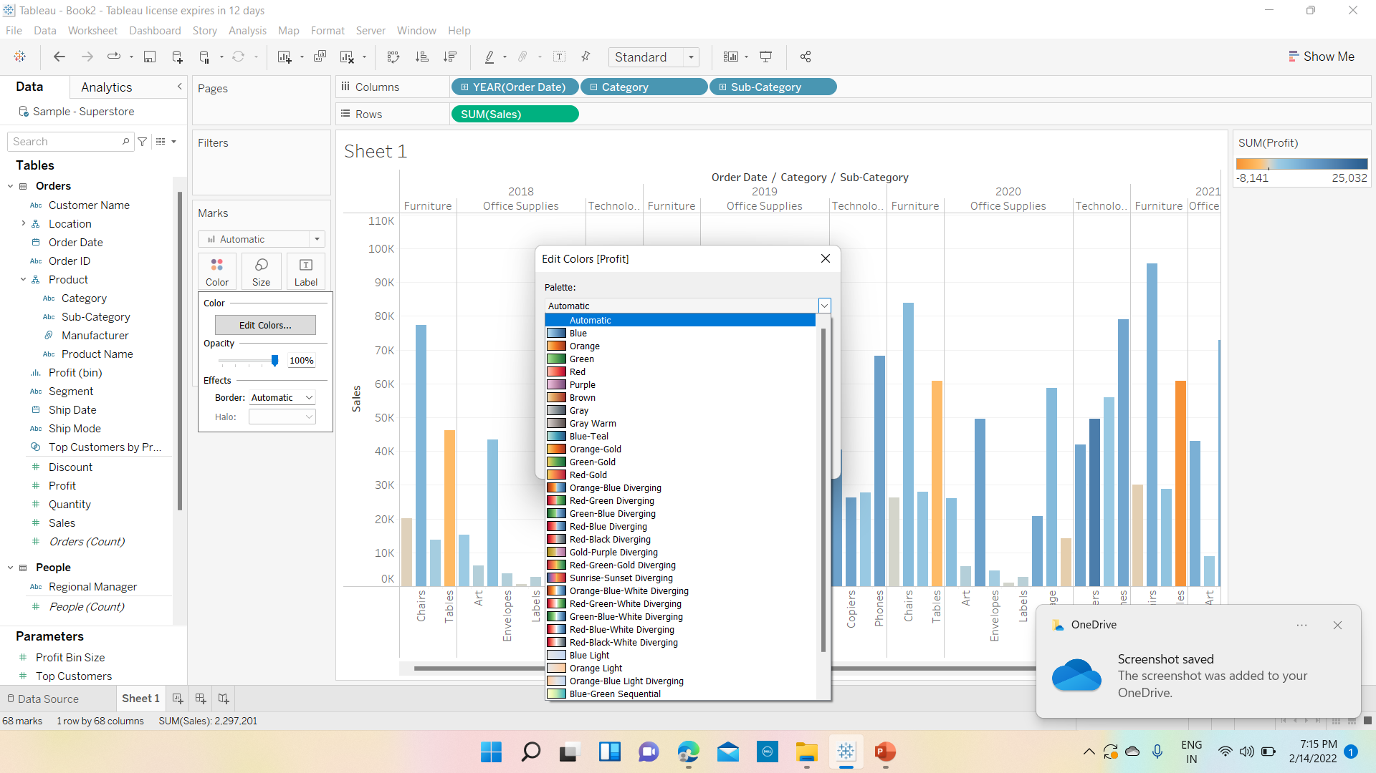
3. In the case 1, change the color of the view from Marks Card

Slide 10
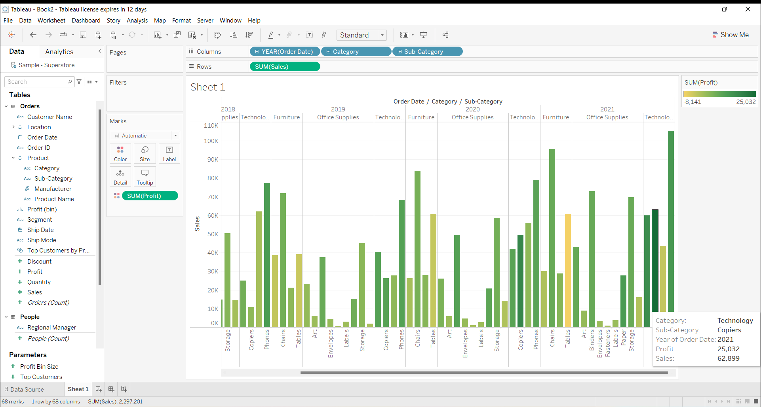

Slide 11
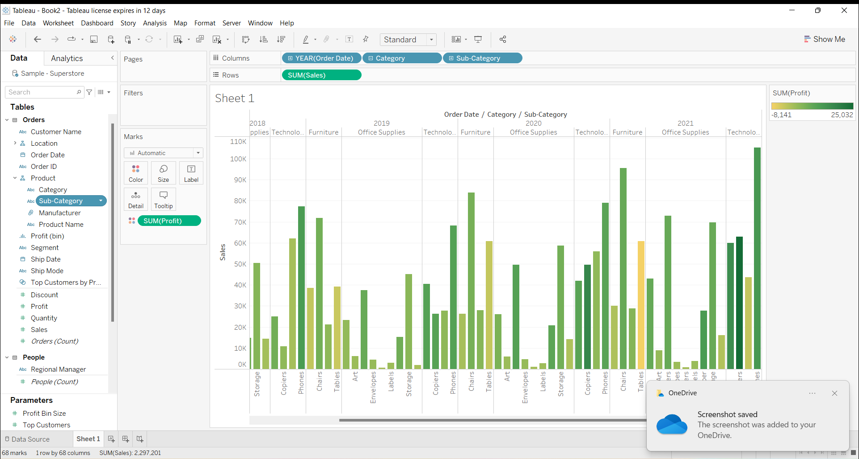
4. In the view, in the sub category filter card clear all of the check boxes except Bookcases, Machines and Tables to have closer look on each value

Slide 12
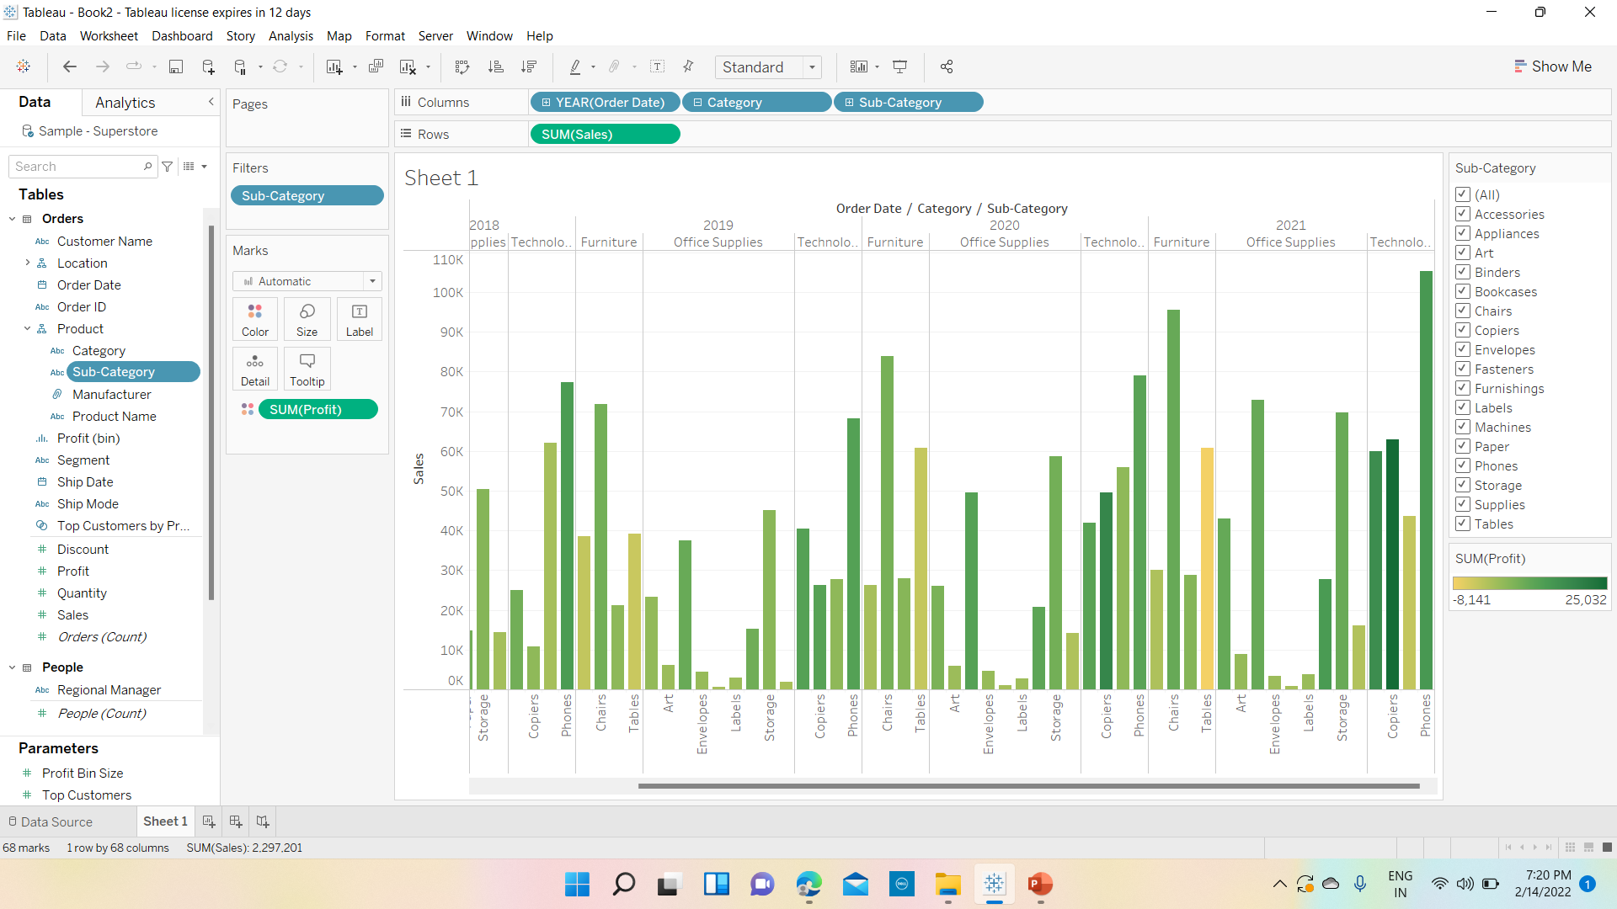

Slide 13
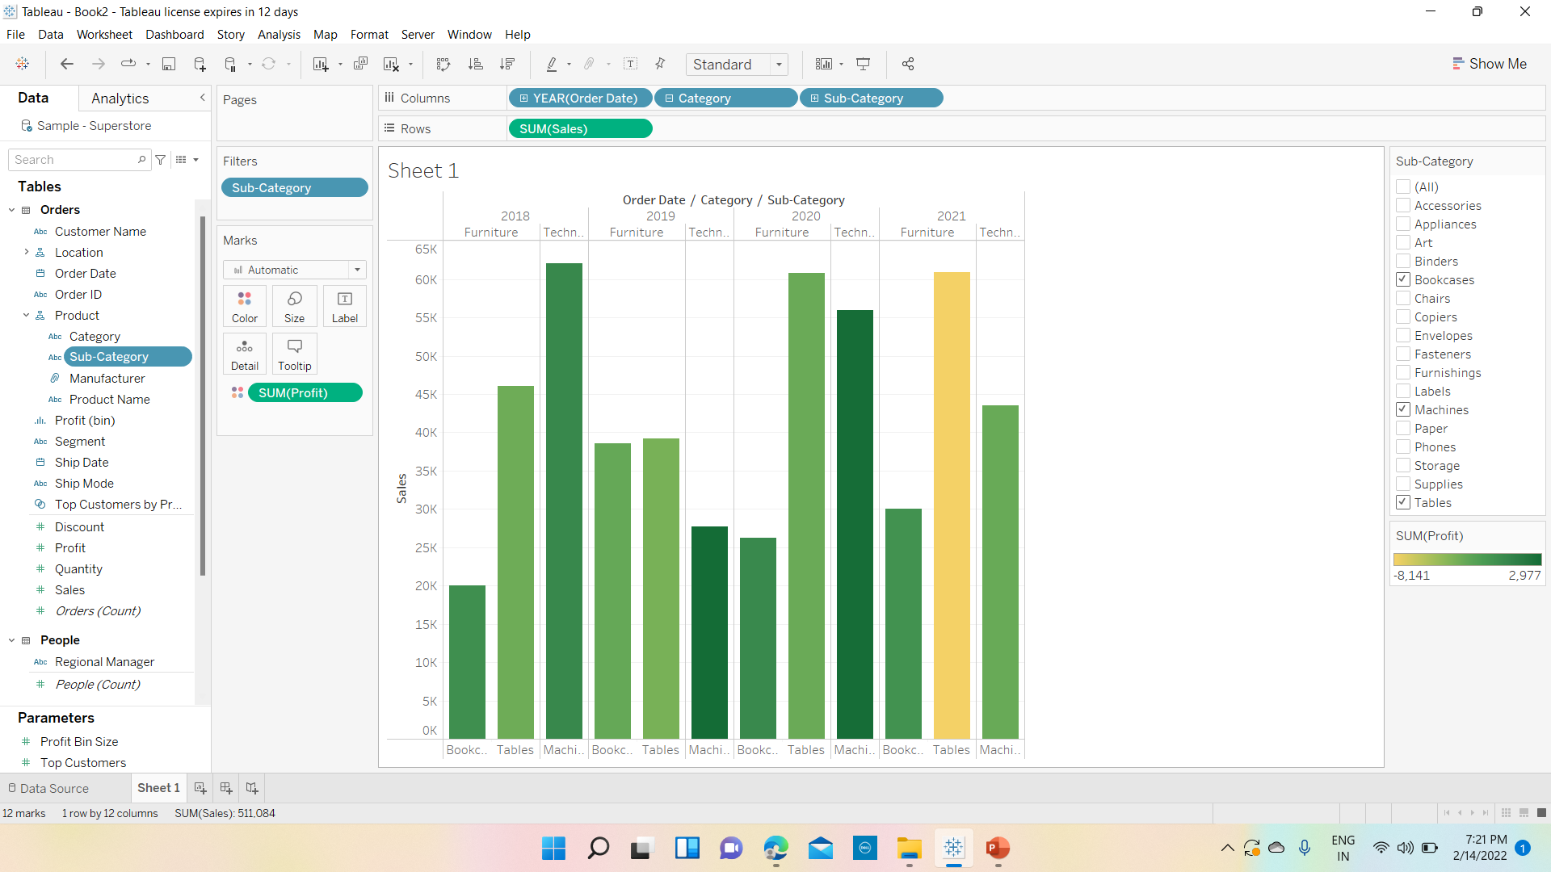

Slide 14
5. Find out the key insights about in which year Bookcases and Machines were profitable and unprofitable

Slide 15
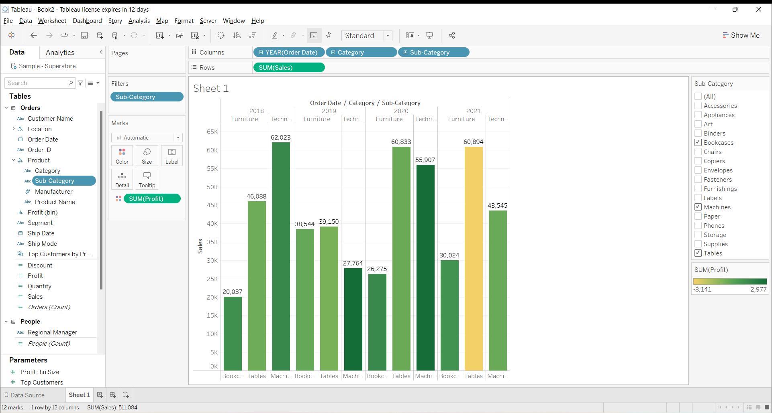


Book cases : profit was in 2020 and for Machines profit was in 2018,2019 and 2020

Slide 16
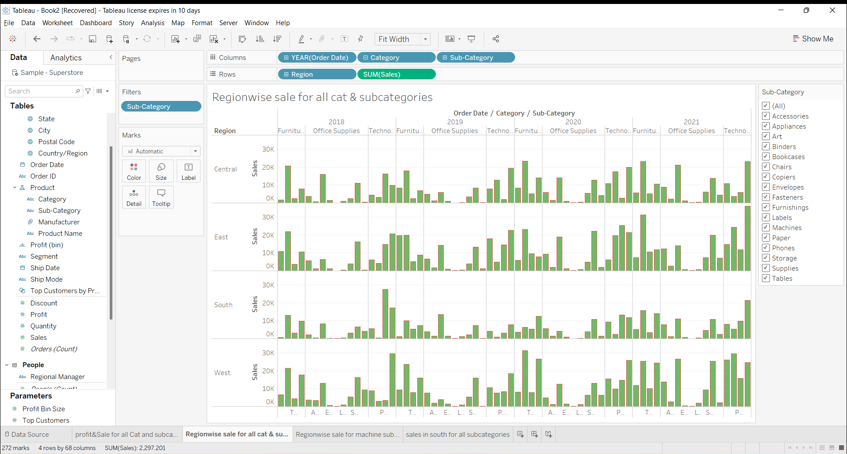
6. Show the sales region-wise for every subcategory and category and every year

Slide 17
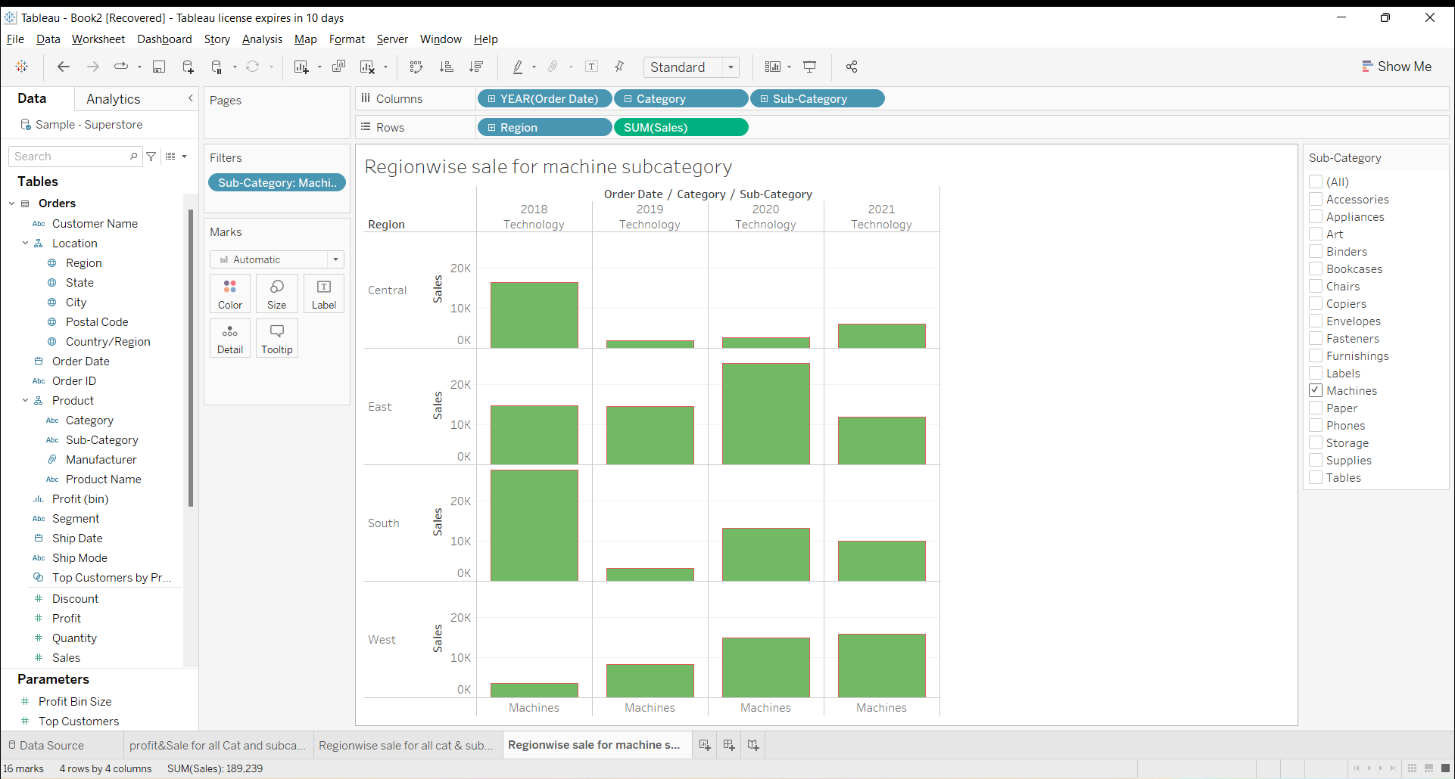
7. Duplicate your worksheet and check sales region-wise for machine type subcategory

Slide 18
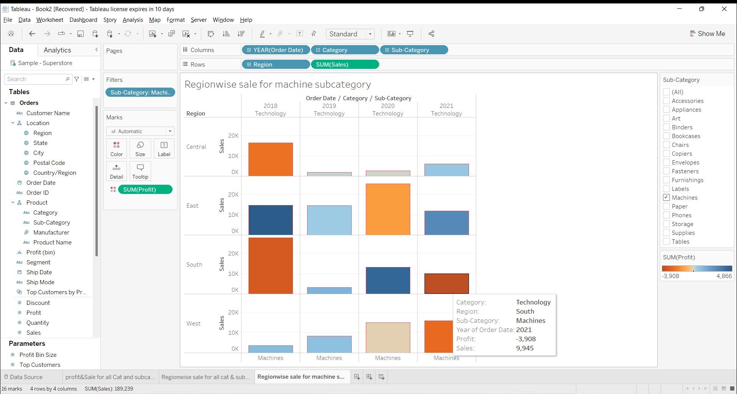

8. In which region you are reporting a higher negative profit overall than in other region

Slide 19
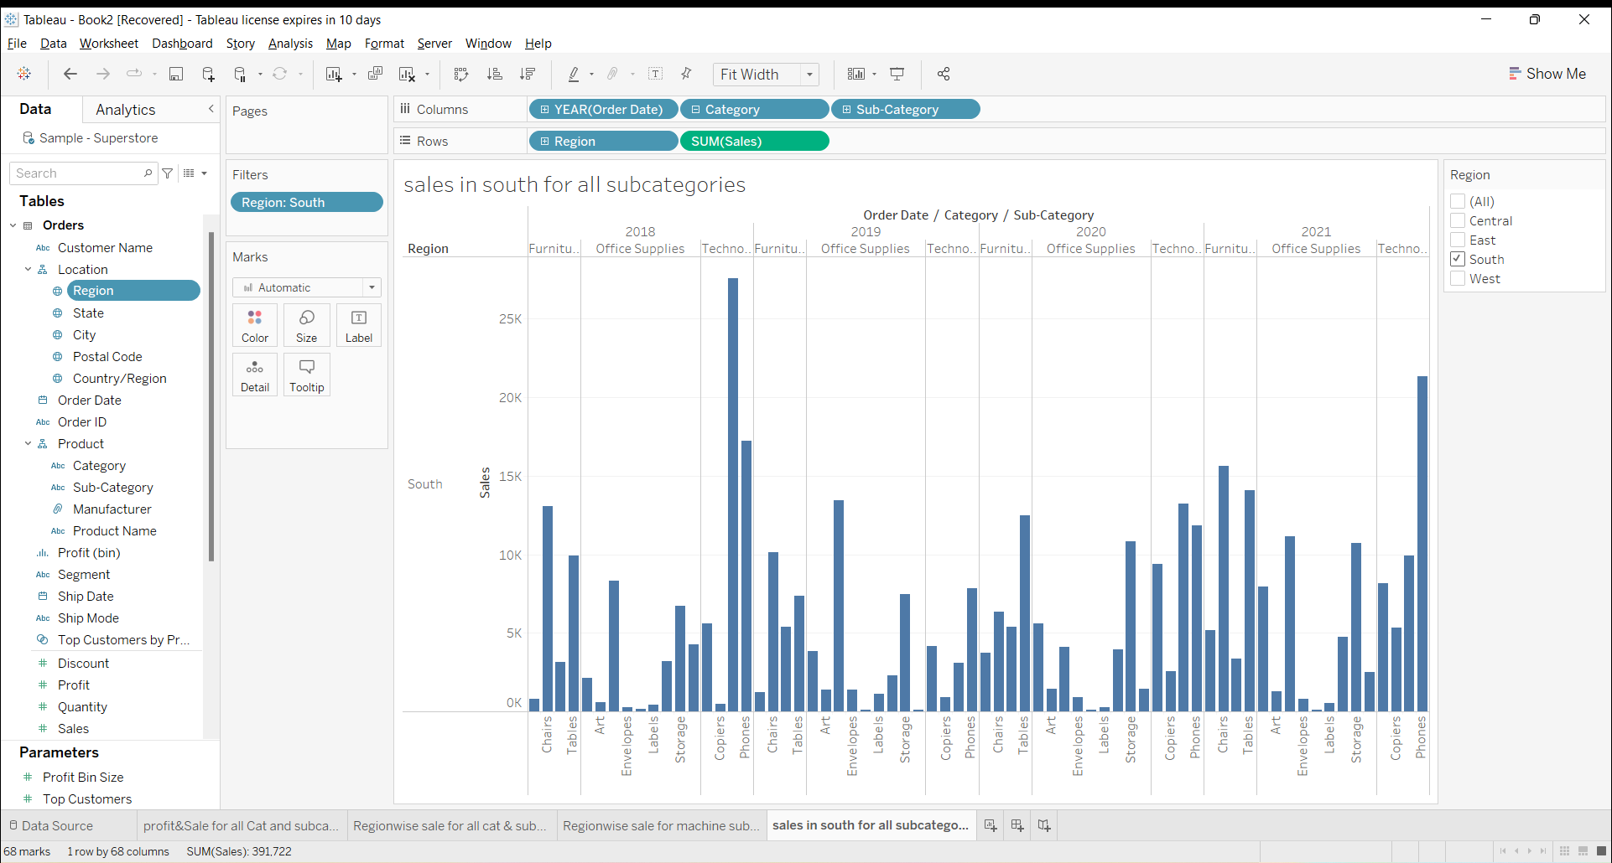
9. Show your view for sale in the south for all category

Slide 20
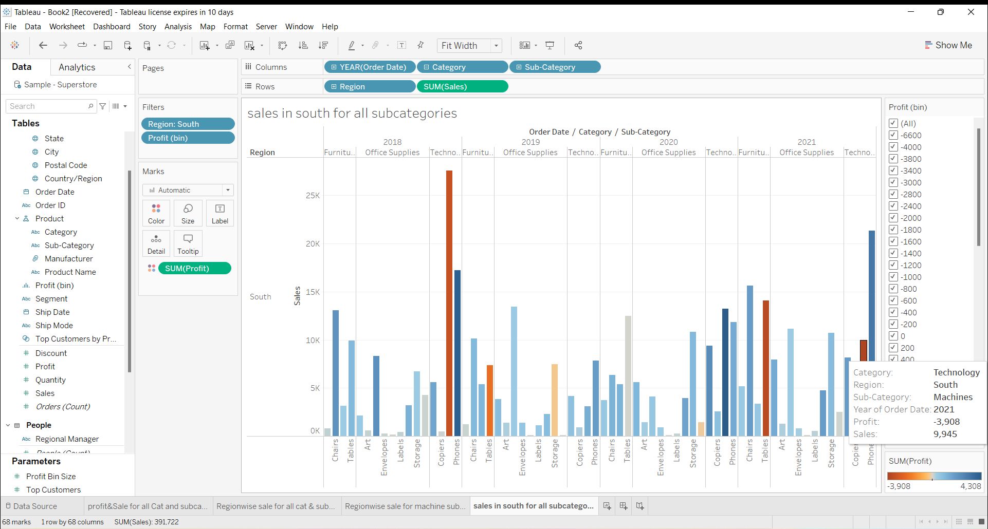
10. Which subcategory has highest overall negative profit in the south region?

Slide 21
11. Take some decision to improve profit in the south region
Ways to improve the profit in the south region:
1. Category-wise, furniture category has recorded highest (-584) negative growth (overall profit) so focusing on that may improve overall profit in the region.
If we observe subcategory wise, Machines under Technology category has recorded highest negative profit (-3908) and Phones subcategory wise has recorded positive profit (+3232) in 2021 so focusing on sales under these two subcategories may improve the overall profit in the region.

Slide 22
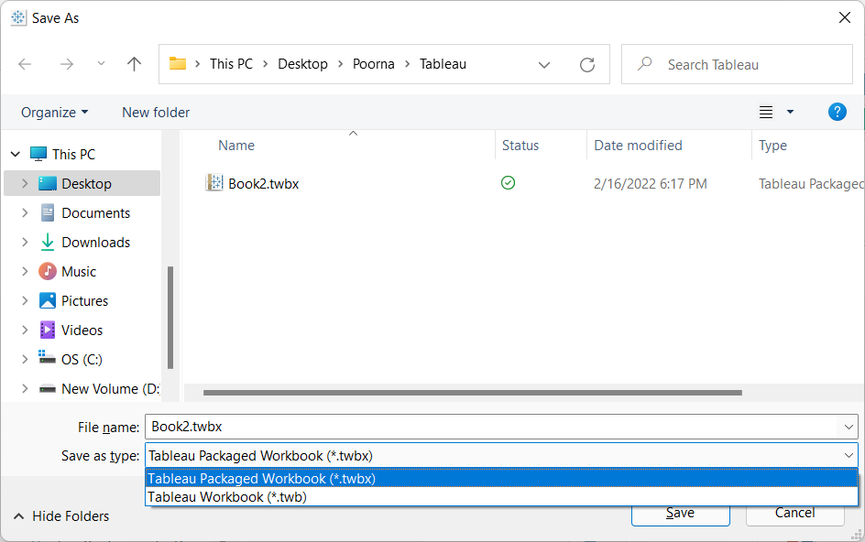
12. Rename the worksheet 13. Save the workbook

